Slide 1
Module 1: Python & Spark Essentials

Slide 2
Lessons:
Python
Spark
Data-Preprocessing
It’s a programming language which is user-friendly in terms of coding and it has easy syntax.
We have PySpark which is a python API which supports Apache Spark functionality
It is possible because of Py4j library .
With the help of PySpark we can install Apache Spark and Python on our machine.
open-source cluster computing framework.
Its main purpose is to handle the real-time generated data.
It’s the step that comes after getting the data.
You try to convert the raw data into meaning data by applying some data pre-processing techniques.
It helps to visualize data and also to get good prediction results when training a model.

Slide 3
Lesson-1 PYTHON ESSENTIALS

Slide 4
Python Essentials:
1. Numpy :-
Numpy stands for Numerical Python.
It’s a python library that is used to work with arrays.
Lists also has functions related to arrays, but they are slow to process
Numpy aims to provide an array object that up to 50x faster than lists because NumPy arrays are stored at one continuous place in memory unlike lists, so processes can access and manipulate them very efficiently.
The array object in named ndarray. Its n-dimensional array.
2. Scikitlearn:-
It’s a machine learning library for python
Based on your requirement you are open to use various classification, Regression, clustering algorithms.
3.Matplotlib:-
Data Visualization library which would help us to visualize data using different graph plots to do EDA.
Matplotlib can be used for 2d plots and is built on Numpy arrays.

Slide 5
Lesson-2 SPARK ESSENTIALS

Slide 6
Why Spark?
It performs In-memory computation.
It's called as Lazy Executor but at the same time once action is called it does parallel processing.
It supports batch as well as real-time processing whereas Map-Reduce lacked with real-time processing.
It leverages Apache Hadoop for both storage and processing. It uses HDFS (Hadoop Distributed File system) for storage and it can run Spark applications on YARN as well.
It has the capability to load data directly from memory, disk and other data storages like Amazon S3, HDFS, Cassandra.
It’s read once and then till last execution it will not store to storage. This resulting faster than Hadoop Map/Reduce(caching).

Slide 7
Benefits of Using Spark?
Fast - It provides high performance for both batch and streaming data, using a state-of-the-art DAG scheduler, a query optimizer, and a physical execution engine.
Easy to Use - It facilitates to write the application in Java, Scala, Python, R, and SQL. It also provides more than 80 high-level operators.
Generality - It provides a collection of libraries including SQL and DataFrames, MLlib for machine learning, GraphX, and Spark Streaming.
Lightweight - It is a light unified analytics engine which is used for large scale data processing.
Deployment(Runs Everywhere) - It can easily run on Hadoop, Apache Mesos, Kubernetes, standalone, or in the cloud.

Slide 8
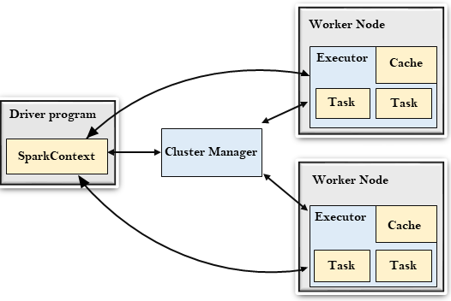
Spark Architecture

Slide 9
Spark Terminologies
Driver Program - It creates Spark Context( ) object which acts like an entry point to spark. It is responsible to connect to cluster manager and reserve executors on node in the cluster.
Cluster Manager - It handles allocating/deallocating resources as it is having the capability to run large number of clusters. There are different types of cluster Managers named Hadoop YARN, Apache Mesos & Standalone Schedular.
Worker Node - Also called as slave node. It’s used to process your data.
Executor - Controls worker node are working on the task mentioned in a spark job.
Task – A unit of work that you want to be done which is sent to one of the executors.

Slide 10

DEMO
Git Hub link

Slide 11
Thank you

